Slide 1
Internal NEA Crystalline Club Use Only: Do not cite or distribute
CrysChem Database Maintenance and Processing, Version 1.0
Kate Weiksnar
Paul Mariner
Sandia National Laboratories (SNL)
NEA Crystalline Club
Internal Document
SAND2025-xxxxx
Sandia National Laboratories is a multi-mission laboratory managed and operated by National Technology and Engineering Solutions of Sandia LLC, a wholly owned subsidiary of Honeywell International Inc. for the U.S. Department of Energy’s National Nuclear Security Administration under contract DE-NA0003525.

Slide 2
Overview
CrysChem Database Overview
What is it
How to navigate it
Maintaining and Updating the Database on Mendeley.com
Master database
New entries database
Sharing the Database
Internally via Mendeley.com
Externally by generating downloadable .bib or .xml file
Generating the downloadable database files
How to export from Mendeley.com
How to generate a universal .bib file to share using python

Slide 3
CryChem Database Overview
What is the CrysChem Database?
A comprehensive collection of references to publications containing chemistry-related data and models potentially relevant to a deep geologic repository in crystalline rock.
Managed using Mendeley.com.
Key Features:
Organized, accessible, and searchable collection of references.
Includes abstracts for keyword searches and synopses of publication contents.
Links provided for locating full documents online.
Unique Aspects:
Contains reports often overlooked in internet searches.
Includes many publications from international geologic disposal programs and underground research laboratories.
Tagging System:
Tags for filtering references by:
Rock and groundwater data from specific countries.
Languages of the publications.
Four main topics related to deep geologic disposal or nuclear waste .

Slide 4
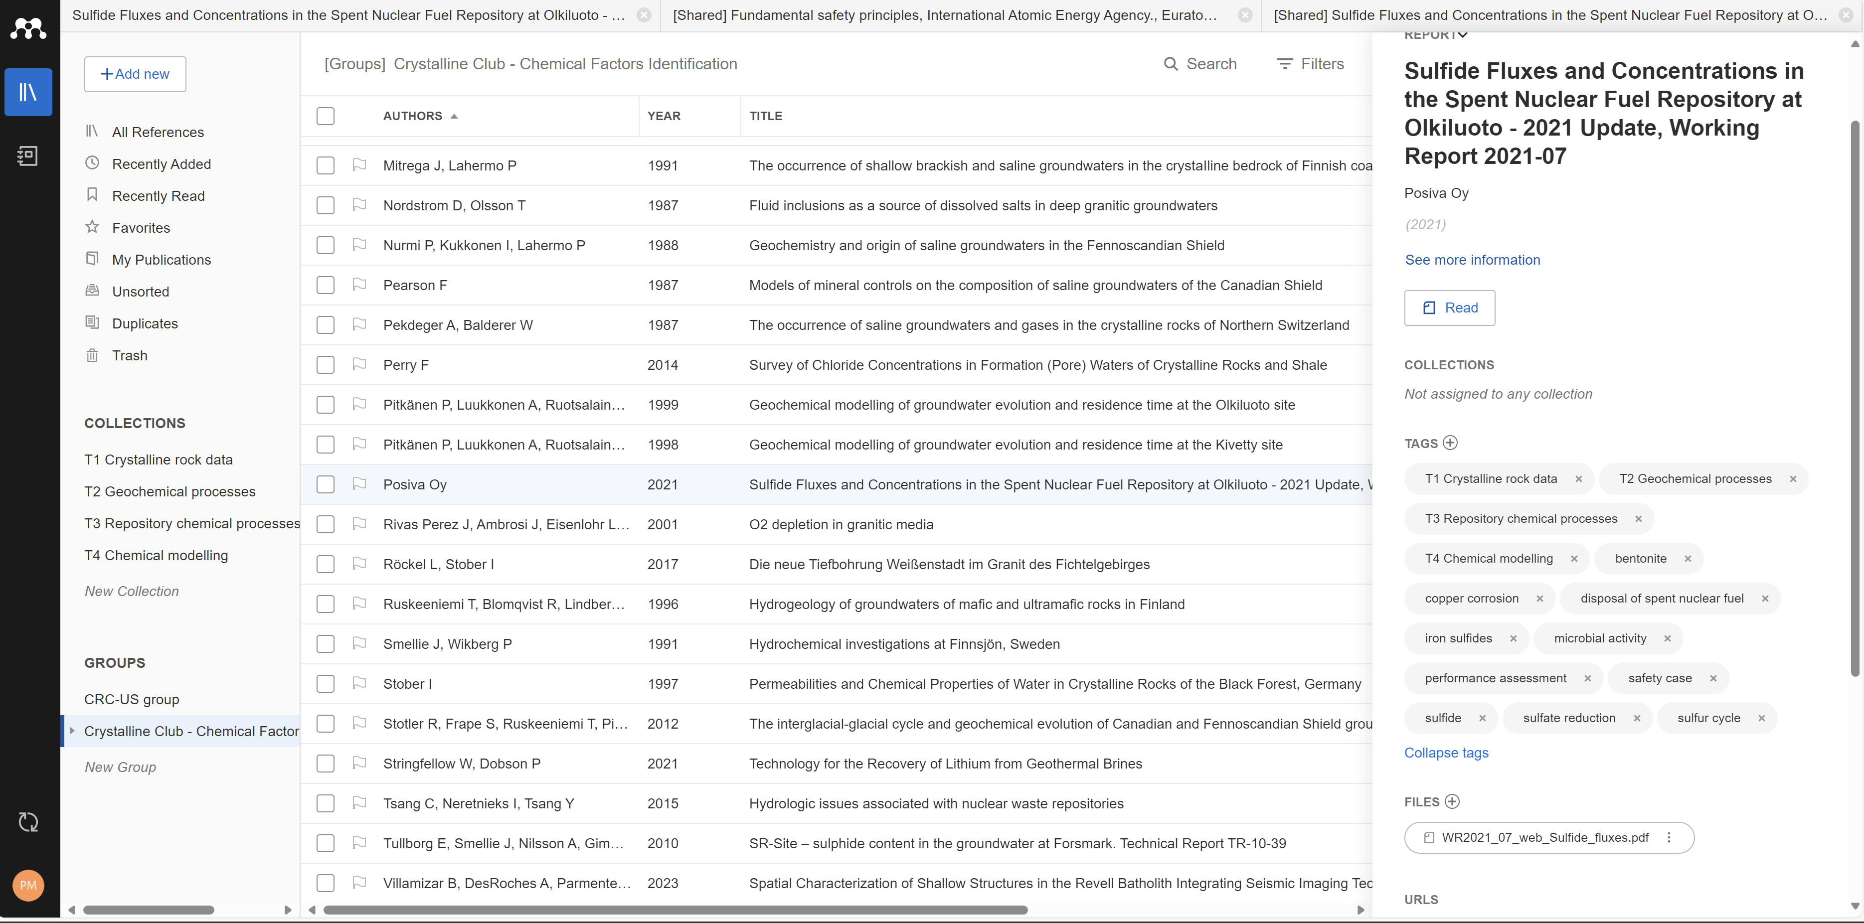
Mendeley CrysChem Database – Navigation
For reports, there currently is no Report ID field, so include in title for now
Collection topics (not populated until the end)
Details
File ok to include because not copyrighted?
CRC Chemical Factors Group Library
No. Guidance is not to upload any publications

Slide 5
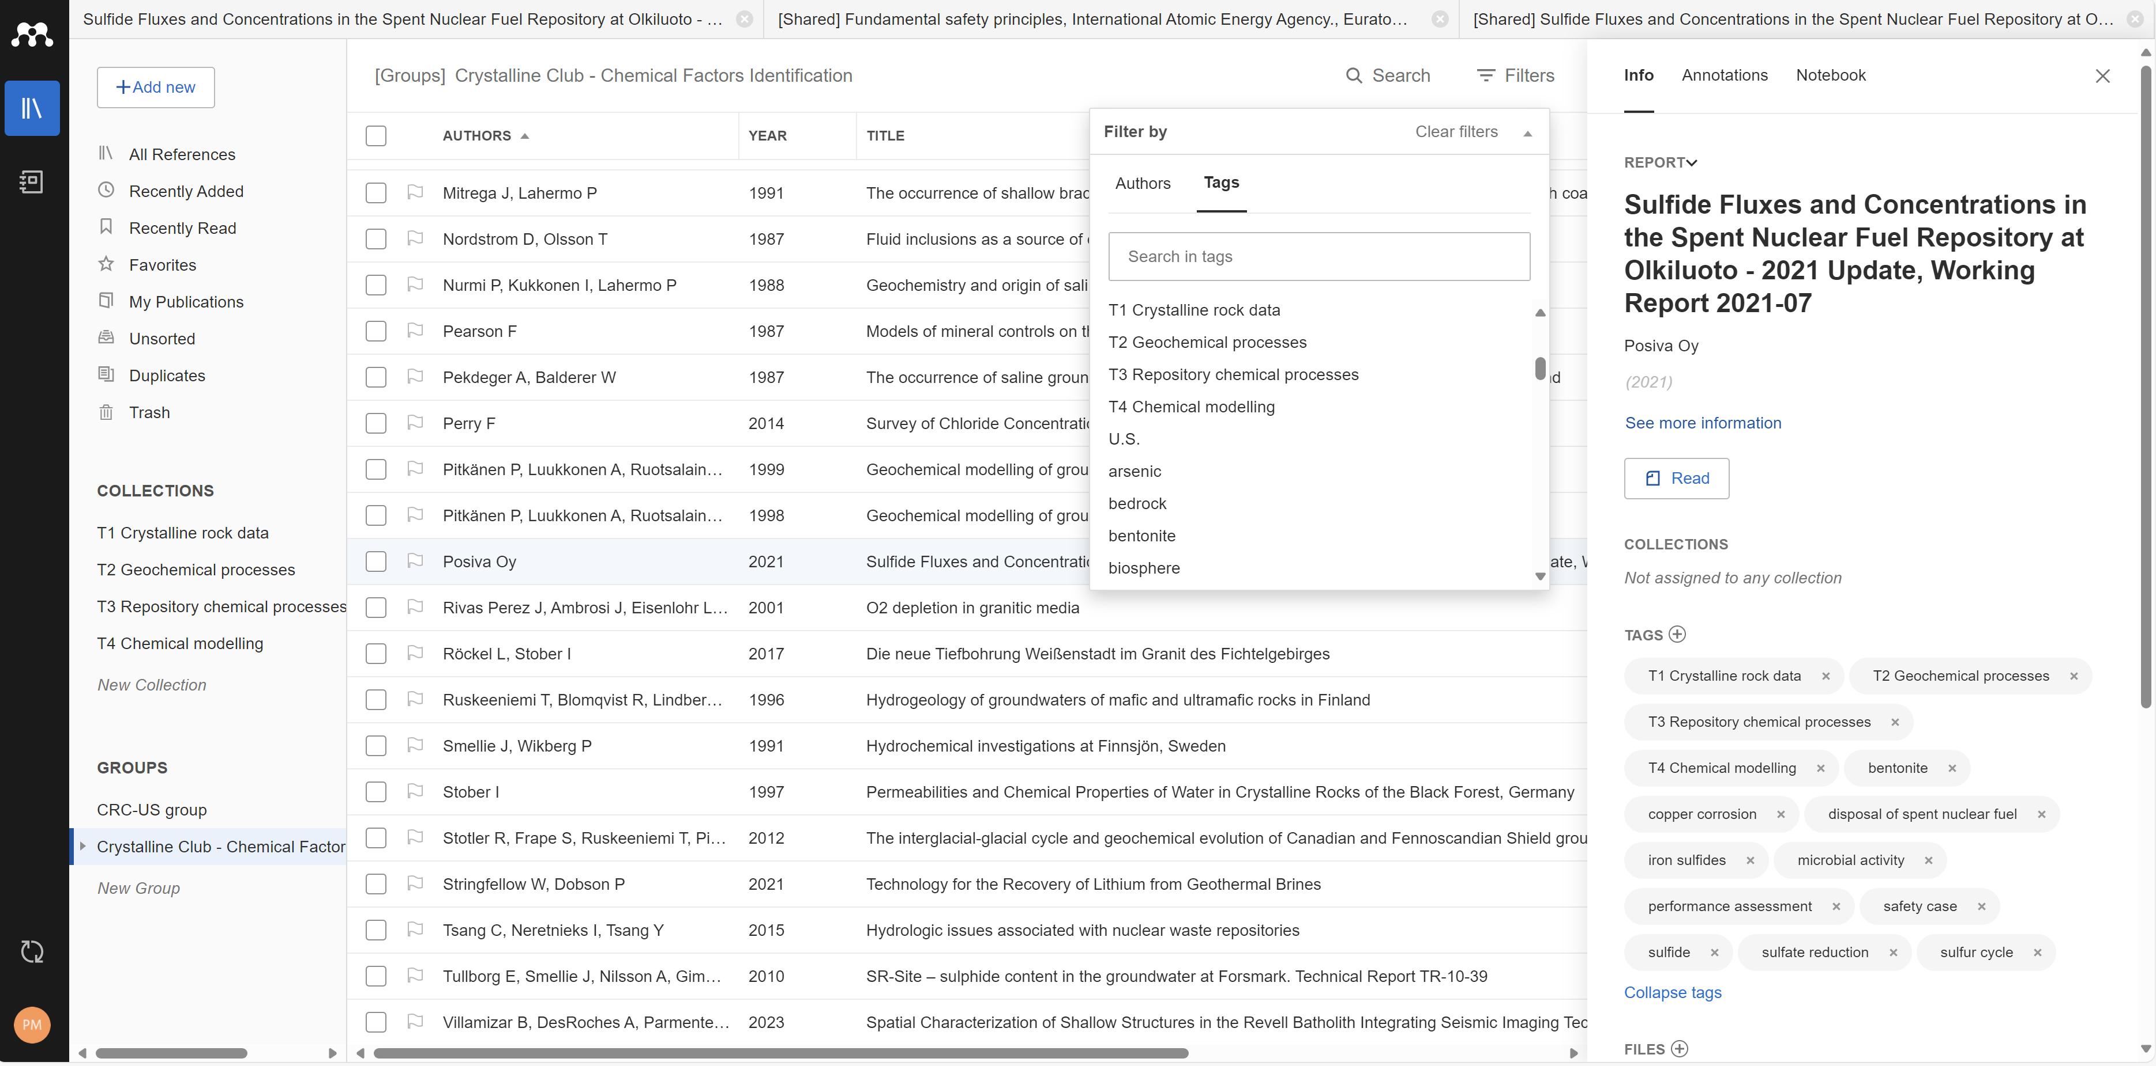
Mendeley CrysChem Database – Library Tags
Current list of tags is found here
Alphabetical (capitalized tags first)
This report applies to all collection topics, so each collection tag is added for this one. (Missing: country tags for the crystalline rock data)

Slide 6
Maintaining and Updating the Database
The CrysChem database will be maintained on Mendeley.com
Two databases on Mendeley.com
Crystalline Club - Chemical Factors Identification
Fully checked database
Only administrators should make changes to this
Crystalline Club - New Entries_Chemical Factor Identification
Collection of new references to add
Administrators will fully check references as outlined in the report and will merge them into the main database when ready
Quality control
The downloadable .bib files will be generated, uploaded to the GitHub website for sharing, and saved to the internal developer GitHub site
Archiving these files on the GitHub site will help ensure that the database records will not be lost

Slide 7
Sharing the CrysChem Database
NEA CRC members
The Mendeley.com database is available to CRC members but not the general public
Public download
A universal database file (.bib) will be available at the CRC GitHub website
This universal file can be imported into Mendeley, Zotero, and other database software
Generation of this file is explained in the remaining slides

Slide 8
Generating the Downloadable Database File
The following slides include instructions for downloading the database from Mendeley (.bib and .xml) and using an example python code to convert the files into a universally compatible reference file (.bib).
This process involves
Exporting the data records from Mendeley into files of 3 different types
Correcting source types and tags
Extracting report numbers from the title fields of the Mendeley database and placing them in the .bib report number field
Changing input parameters from Mendeley formatting to universal compatibility
Writing the .bib file
Adding the abstracts in the exported .xml file to the .bib file and checking that they were added correctly

Slide 9
Step 1: Open the Mendeley application and navigate to the Crystalline Club- chemical factors identification under “GROUPS”.
1
CRC Chemical Factors Group Library

Slide 10
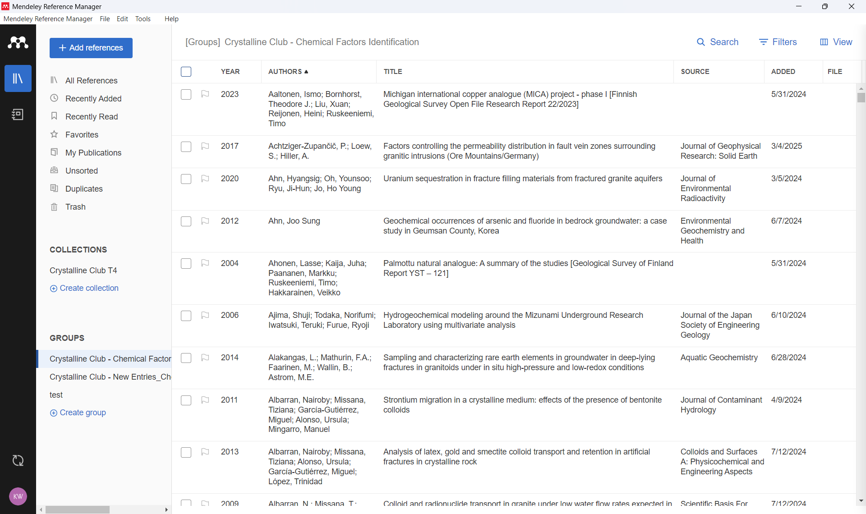
Step 2: Click the box at the top of the database to select all the entries in the group. When clicked, the box should highlight blue with a check (or other indication of selection) and should select all entries in the database. In this case, 667 references were included in the database.
2

Slide 11
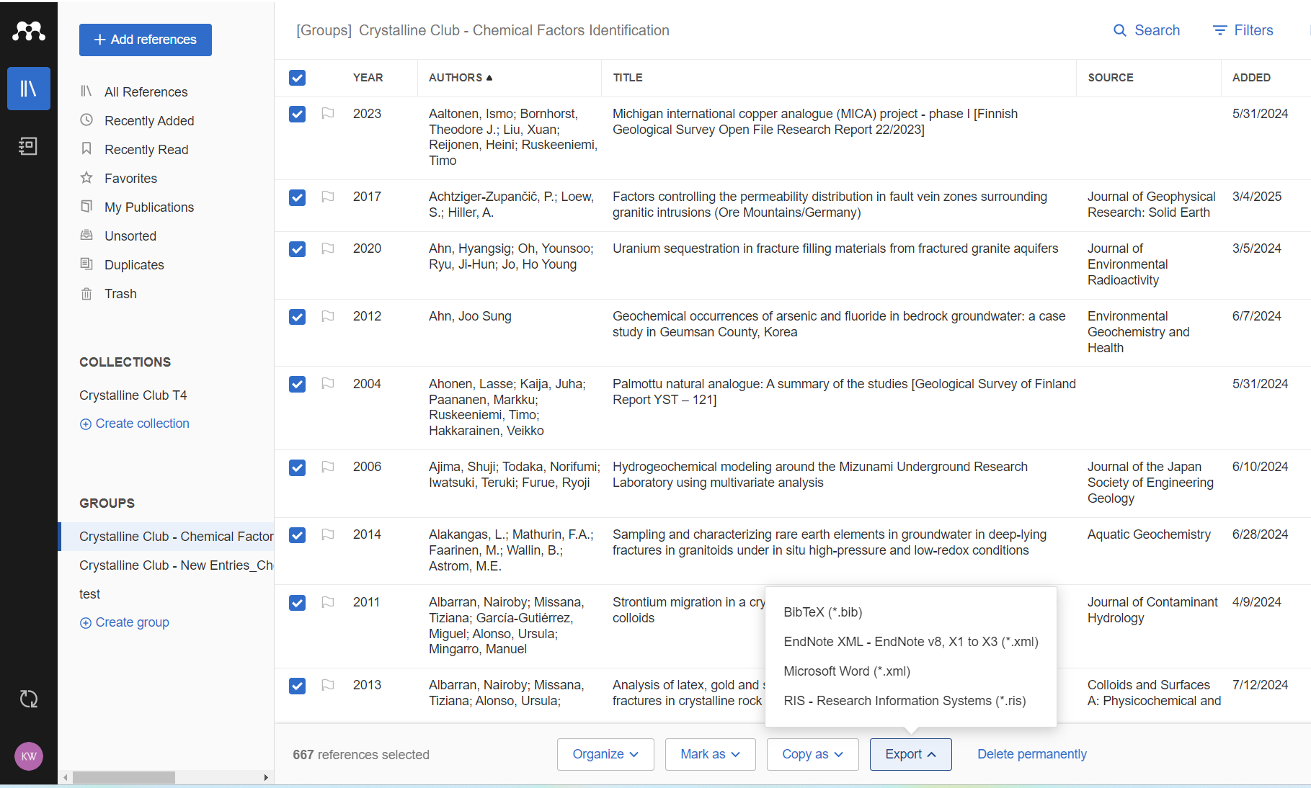
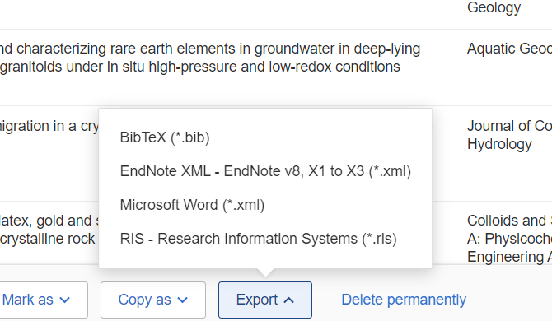
Step 3: Exporting the database
With all the entries selected, click the export button at the bottom of the screen. A drop box will appear with four export types: BibTex (.bib), EndNote XML(.xml), Microsoft word (.xml), and Research Information Systems (.ris). Depending on the purpose of the export, any of these may be appropriate.
For creating a version of the database that maintains report numbers, abstracts, and tags, you will need to export three of the file types: BibTex, EndNote XML, Microsoft word xml.
3

Slide 12
Step 4: Use code to combine the three exported files into a “universal” reference file.
The next several slides will go through the code used to accomplish this.
The code was written in python using Jupyter Notebook.

Slide 13
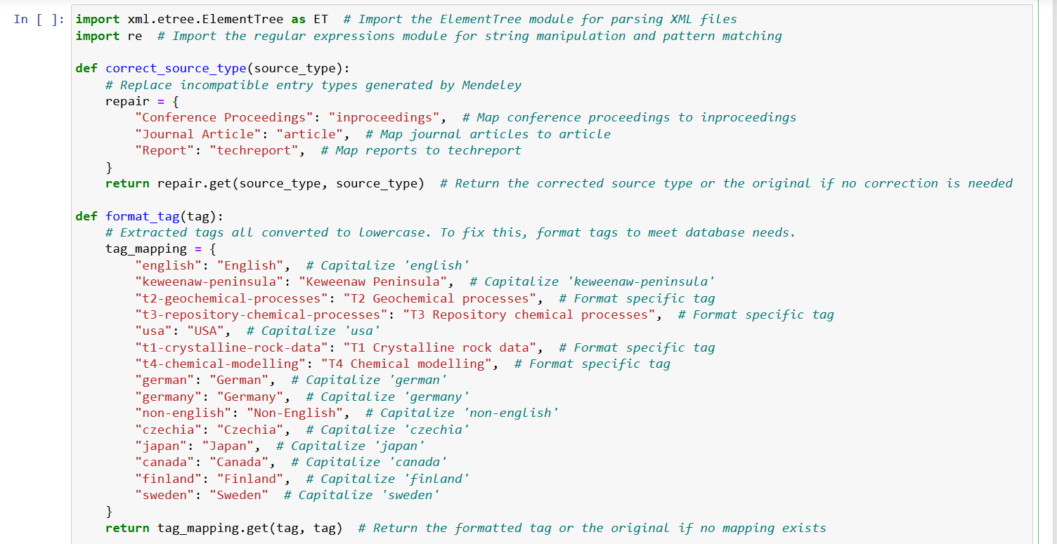
Step 4a) Beginning the module, correct the source type, correcting the tags:

Slide 14
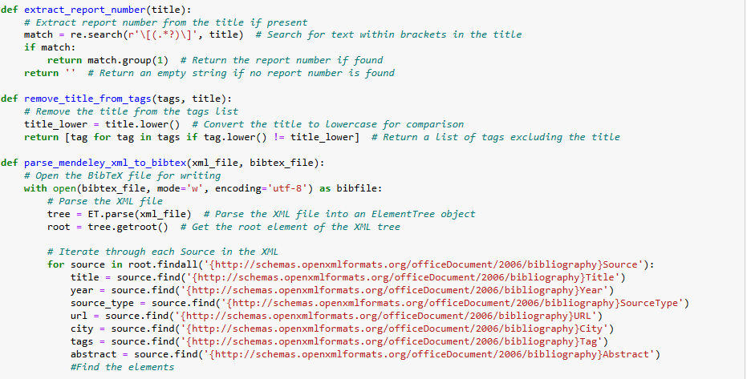
Step 4b) Extract report number from Mendeley title and add it to report number section in Bibtex file.

Slide 15
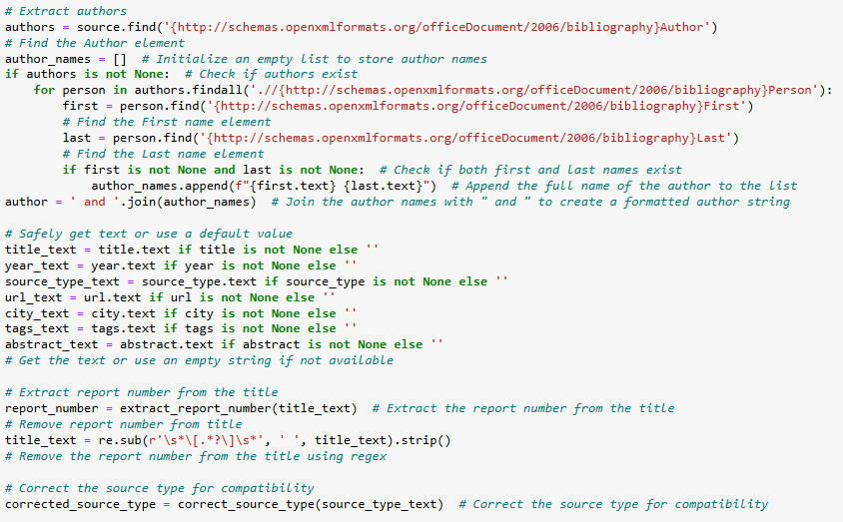
Step 4c) Change input parameters from Mendeley formatting to universal compatibility (report number, source type, keywords)

Slide 16
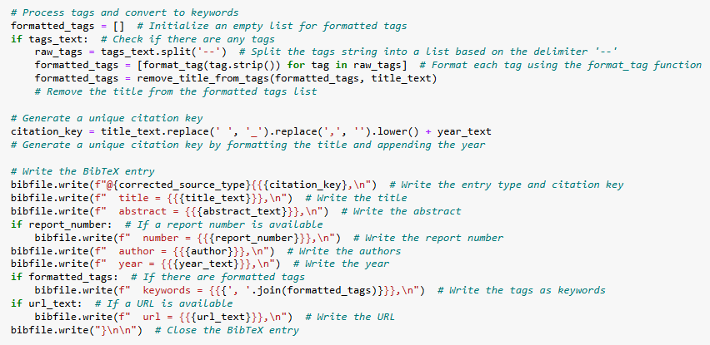
Step 4d) write new universal .Bibtex file. This file does not contain abstracts yet.

Slide 17
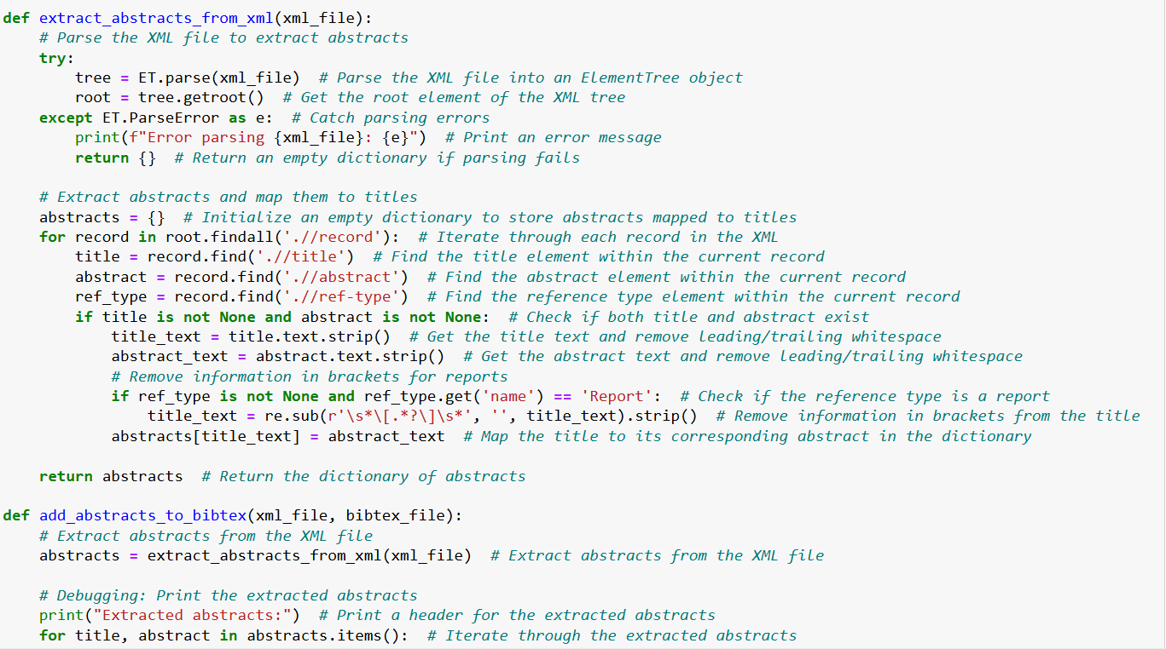
Step 4e) Extract abstracts and title from xml file. Link abstracts to respective titles in the bibtex file.

Slide 18
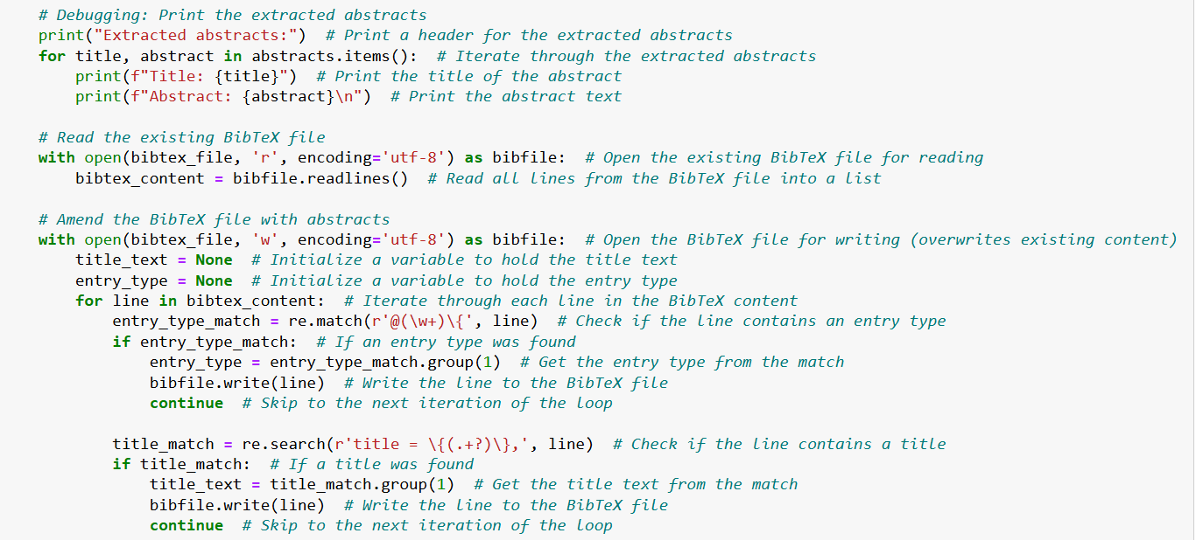
Step 4f) Debugging: check to make sure abstracts were extracted from the XML file and imported to the Bibtex file with the appropriate titles.

Slide 19
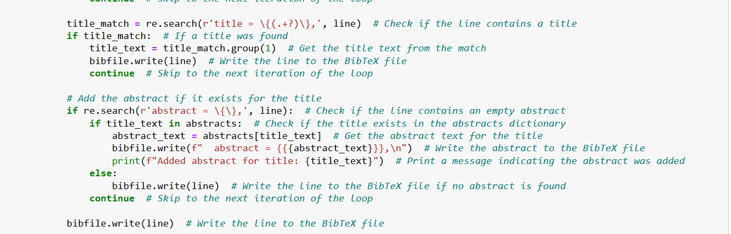
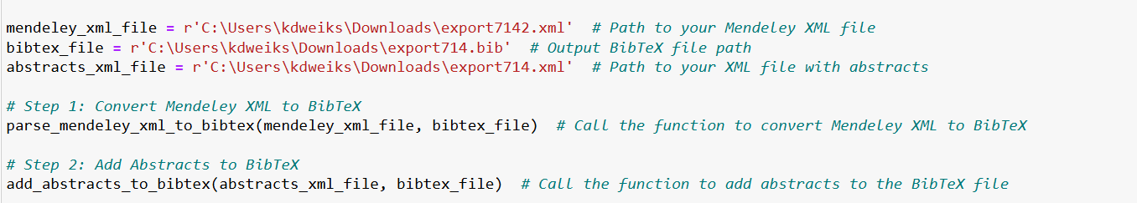
Step 4g) Add abstract to title. Incorporate into BibTex File

Slide 20
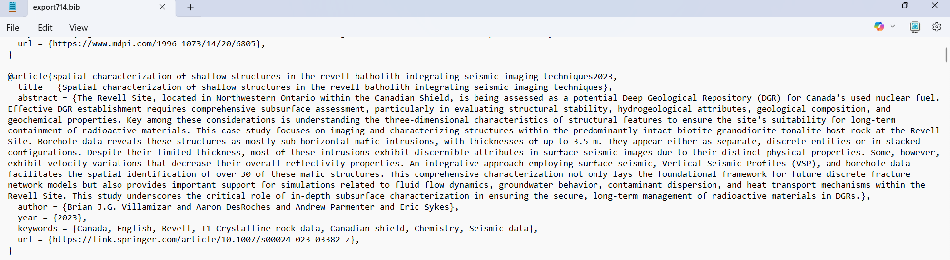
Step 5: Now you should have a BibTex file with all the appropriate information that is compatible in other references managers. Example format:
Entry type
Title
Abstract
Author
Year
Tags/ Keywords
This file can be used for the statistics for the report or uploaded to the CrysChem database website and should contain all references and relevant information for the database.

